Slide 1
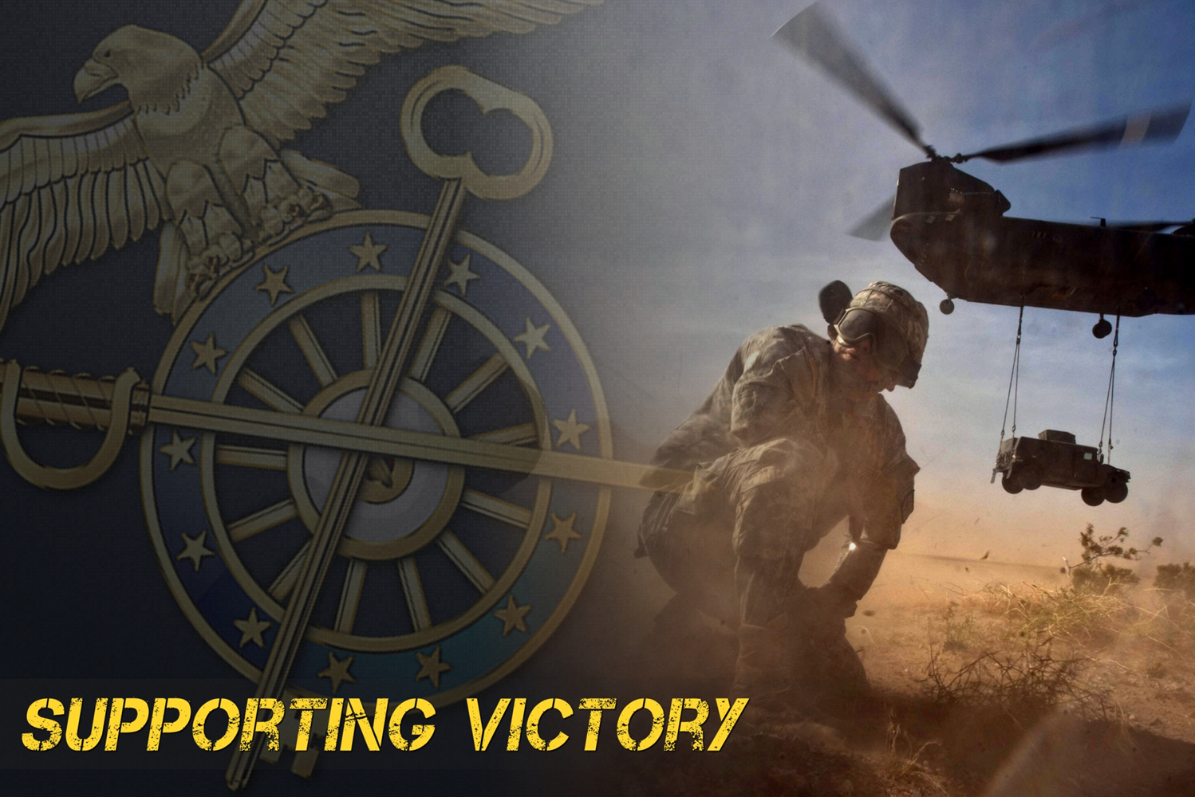
Quartermaster Corps
Supporting Victory!

Slide 2
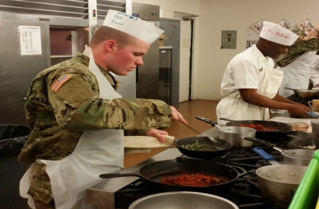
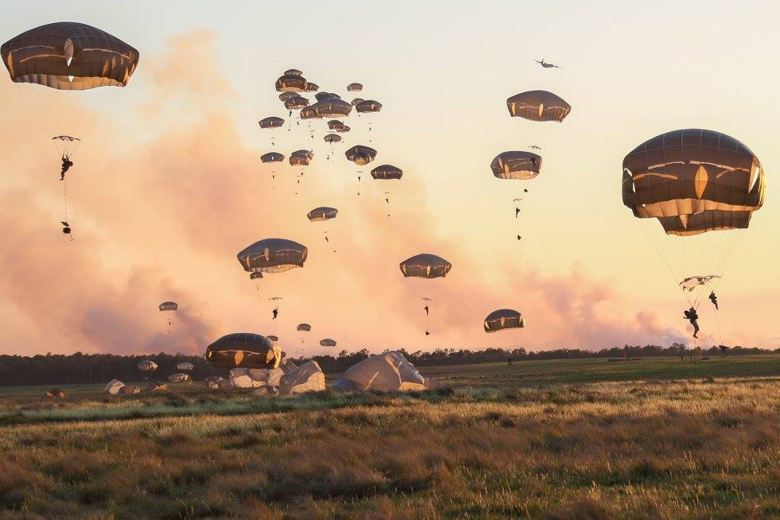
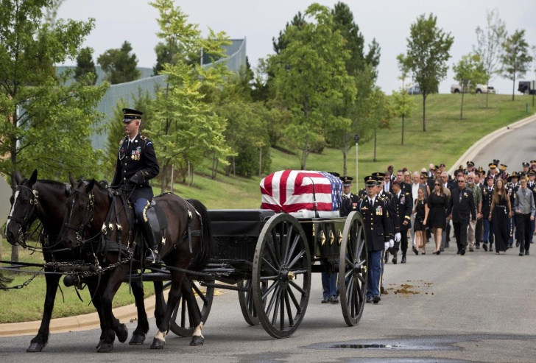
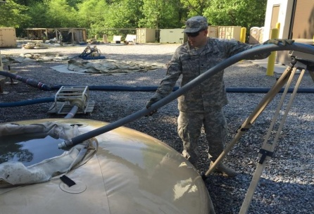
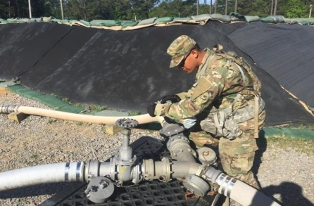
Agenda
Quartermaster to Multi-functional Logistician
Quartermaster Corps Mission
Quartermaster Core Competencies
Why Choose Quartermaster Corps
Quartermaster Basic Officer Leadership Course (BOLC)
Active Duty, US Army Reserve Location, National Guard Locations
Quartermaster Contacts
Quartermaster Overview

Slide 3

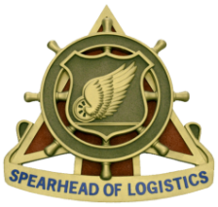
Quartermaster to Multi-functional Logistician
Logistics Commissioned Officers will begin their Careers as a second lieutenants assessed in either the Quartermaster Corps (QM), Ordnance Corps or Transportation Corps.
Quartermaster officers are inducted into the Logistics Corps upon graduation from the Logistics Captain’s Career Course. Subsequently, they are assigned to both multifunctional logistics assignments and Quartermaster functional assignments. The Area Of Concentration (AOC) 90A becomes their primary AOC with a secondary AOC of 92A (90A92).

Slide 4
Quartermaster Corps Mission
The Quartermaster Corps provides integrated logistics support to sustain Soldiers, units and their equipment in war and peace.
Notes:
History and background. The Quartermaster Corps traces its origins to 16 June 1775. From 1818 to 1860, then
Quartermaster General Brigadier General Thomas Sidney Jessup, the “Father of the Quartermaster Corps,” instituted an
improved system of property accountability and experimented with new modes of transportation, including canal boats
in the east, camel caravans in the desert southwest and early railroads. During the Civil War, Quartermasters purchased
clothing, equipment, animals and services at an unprecedented pace. In 1862, the Quartermaster Department assumed
responsibility for burial of war dead and care of national cemeteries. In 1912 Congress consolidated the former
Subsistence, Pay and Quartermaster Departments in order to create the Quartermaster Corps as we know it today. It
became a fully militarized organization with its own units trained to perform a host of supply and service functions on
the battlefield. With this consolidation came the missions of subsistence and food service. When the Army began
purchasing motorized vehicles, as early as 1903, the Quartermaster Corps assumed the new petroleum supply mission.
During World War I, the modern era witnessed the first use of specialized Quartermaster units in France including
laundry, bath, salvage depots and port operations. During World War II, the Quartermaster Corps operated on a scale
unparalleled in history, with theaters of operation in the Mediterranean, northern Europe, the Pacific, and even the
China-Burma-India Theater and Bataan, Leyte, Salerno, Normandy, and Bastogne. At the height of the war, Quartermasters
were providing over 70,000 different supply items, more that 24 million meals each day, and recovered and
buried nearly a quarter of a million Soldiers in temporary cemeteries around the world. We can expect that in the future
Quartermaster Soldiers will continue to uphold the regimental motto of “Supporting Victory.”

Slide 5
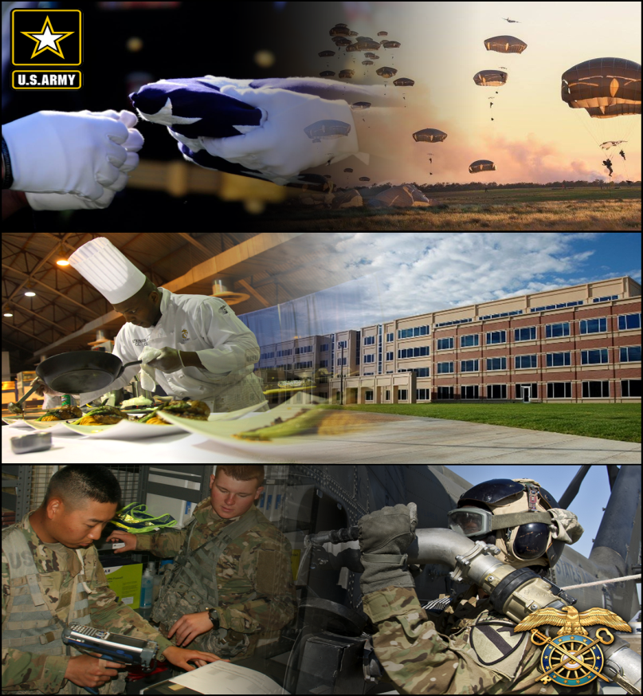
Quartermaster Core Competences
Supply Distribution
92A/92Y – 920A/920B – 90A92
Aerial Delivery
92R – 921A – 90A92R9
Petroleum
92F/92L–923A–90A92R8
Mortuary Affairs
92M – 90A924V
Water
92W – 923A – 90A92R8
Subsistence
92G – 922A – 90A92
Field Services
92S – 90A92
ENL – WO – OFF

Slide 6
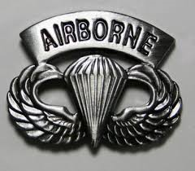
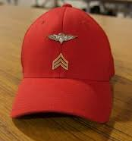
Why Choose the Quartermaster Corps (1 of 2)
General
U.S. Army’s second Oldest Branch
Not Gender restricted
Racially diverse
Promotion potential on-par with Army
average (13-General Officers)
Lieutenant Positions
Platoon Leader (PL) Battalion Staff Officer
- Supply PL - Support Operations (SPO)
- Aerial Delivery PL - S3
- Petroleum PL - S4
- Distribution PL
Assignments
QM officers serve in every Brigade Combat Team and separate brigade in the Army with duties all over the world.
QM Officers lead Soldiers in support of Combined Arms Teams such as:
  Infantry
  Armor
  Field Artillery
  Stryker
  Aviation
Special Officer Skill Identifiers
4V - Mortuary Affairs Officer (2 Weeks)
R8 - Petroleum and Water Officer (8 Weeks)
R9 - Aerial Delivery & Materiel Officer (5 Weeks); Must be Airborne Qualified
Notes:
Joining the Quartermaster Corps give you the opportunity to support and sustain the Army’s victories in various functional areas such as Supply Distribution, Aerial Delivery, Petroleum and Water, Field Feeding and develop skills like leading and managing, adaptation skills, innovation progression in a customer focused environment that can take you anywhere in the world that the Army has a presence.
Distribution Platoon (Forward Support Company &
Distribution Company)
Petroleum Platoon
Rigger Platoon
Water Platoon
General Supply Platoon
Mortuary Affairs Platoon
Shower-Laundry-Clothing Repair Platoon
Force Provider Platoon
Accountable Officer in a Supply Support Activity

Slide 7

Why Choose the Quartermaster Corps(2 of 2)
Command Opportunities
Command a Company is a Key Developmental position
Companies are typically Logistically Multifunctional and contain a larger of Soldiers, responsibilities, and equipment
Talent Priorities
Perceptive
(discerns deeper meaning or significance)
Problem Solver
(choose best practices)
Project Manager
(manage resources)
Multi-Tasker
(process and prioritize demands)
Communicator
(compelling in written & spoken word)
Civilian Opportunities
Quartermaster skills and leadership experience gained translates extremely well to civilian employment opportunities.
Additional Information
Quartermaster Website:
  www.quartermaster.army.mil
DA PAM 600-3: Commissioned Officer Professional Development and Career Management

Slide 8

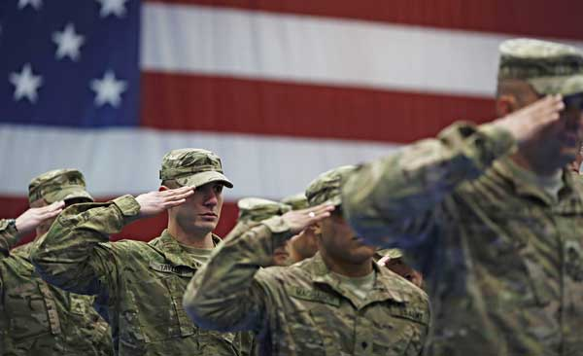
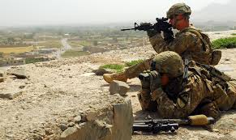
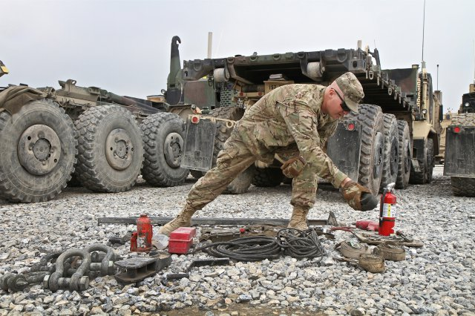
QM Basic Officer Leadership Course
Quartermaster officers are educated professionals, trained to lead Soldiers in all situations. They receive training in Quartermaster specific areas, general leadership and management with increased levels of command experience as they advance.
BOLC Overview
QM BOLC prepares Lieutenants to function as platoon leaders capable of performing common Soldier and leader skills that includes basic knowledge of unit management, technical Quartermaster functions of field services, supply distribution, petroleum and water operations, subsistence management, and general materiel management.
Common Core
16 weeks of developing leadership skills, small
unit tactics, and your branch specific capabilities.
Special Projects:
  Community Service
  Projects
  Socials
Student led Army Physical Fitness Readiness
Location: Army Logistics University (ALU) at
Fort Lee, Virginia
Notes:
35–20. Quartermaster officer characteristics required
Unique knowledge and skills of a Quartermaster officer. Lieutenants gained by the Quartermaster Corps develop
functional branch skills for the first three to 4 years of their career. Quartermaster officers possess one AOC (92A) and
may be trained in one of the following three SIs: petroleum and water/SI R8, aerial delivery and materiel/SI R9, and
mortuary affairs/SI 4V all of which are open to male and female officers. Quartermaster officers upon successful
completion of the CLC3 are inducted into the Logistics Corps. AOC 90A becomes their primary AOC with a
secondary AOC of 92A (90A92). See paragraph 35–4 for an in-depth explanation of Logistics branch officers. These
officers maintain their Quartermaster Regimental Affiliation, and may continue to serve in Quartermaster functional
assignments throughout their career.
a. Quartermaster, Supply and Materiel Management (AOC 92A). Officers command, directs, plans and implements
materiel management and integration into the overall DOD logistics system. They are responsible for service support
functions including, but not limited to, graves registration, clothing and textile renovation, laundry and bath and aerial
delivery. They direct and supervise the collection, evacuation and accountability for all classes of supply classified as
salvage, surplus, abandoned or uneconomically repairable. As a staff officer, they advise commanders on matters
regarding supply and services support as well as unit capabilities. They develop and execute materiel management
programs, to include inventory control and distribution throughout the logistics system. Officers determine and plan
storage requirements for field and permanent depot activities.
b. Petroleum and Water (SI R8). Officers attending the Petroleum Officer Course (POC) may command, direct, plan,
and/or exercise staff responsibility for units engaged in petroleum and/or water operations. Officers direct the acquisition,
storage, inspection, testing, issue, and distribution of petroleum products, and water. They serve in staff positions
requiring petroleum and water experience.
(1) They determine requirements for bulk and packaged petroleum products and water, storage space, distribution
systems, and quality surveillance. Officers recommend locations; direct the operations and user maintenance for
petroleum and water pipelines, hose-line routes, terminals, supply points, and depots. They advise commanders on
water and bulk petroleum distribution system design. Officers plan, coordinate, and supervises loading and discharge of
oceangoing tankers and other petroleum vessels. They direct quality surveillance at point of procurement and throughout
the petroleum distribution system. They direct the operations of base or mobile laboratories in testing of petroleum
products. Officers supervises performance of standard physical and CM tests, evaluate test results to insure products
meet Federal and military specifications, and recommends disposition of off-specification or captured petroleum
products.
(2) Officers determine water requirements, establish and direct operation of water purification, storage, distribution,
and issue systems in support of field operations. They develop, direct, and coordinate water conservation programs
when appropriate. They develop, direct, and coordinate unit procedures and programs on the environmentally sound
handling of petroleum, wastewater, and water treatment CMs. Officers monitor waste disposal procedures for waste
produced by unit petroleum and water operations. They report all unit petroleum, wastewater, and water treatment CM
spills in accordance with applicable laws, regulations, and policies. Officers monitor unit spill containment and cleanup
operations.
c. Aerial Delivery and Materiel (SI R9). Officers attending the Aerial Delivery Materials Officer Course may
command, direct, plan, and/or manage units engaged in storage, packing, preparation, and delivery of materiel by air
drop means. Officers determine requirements for and plan the employment of aerial delivery systems in support of
DA PAM 600–3 • 3 December 2014 385
tactical and special operations. They command, direct, supervise, and train personnel engaged in the storage, packing,
and preparation of materiel for aerial delivery distribution. They plan and supervise the inspection, repair, testing,
packing, rigging, and storage of parachutes, allied assemblies, aerial delivery containers, airdrop kits, and cargo
parachutes. They advise and assist in the coordination of transportation requirements to include recovery of airdrop
equipment.
d. Mortuary Affairs (SI 4V). Officers attending the Mortuary Affairs Officer Course may direct, plan, and coordinate
MA support for military operations and civil mass fatality operations. Officers are involved in recovery, tentative
identification, and evacuation of deceased U.S. military personnel.

Slide 9


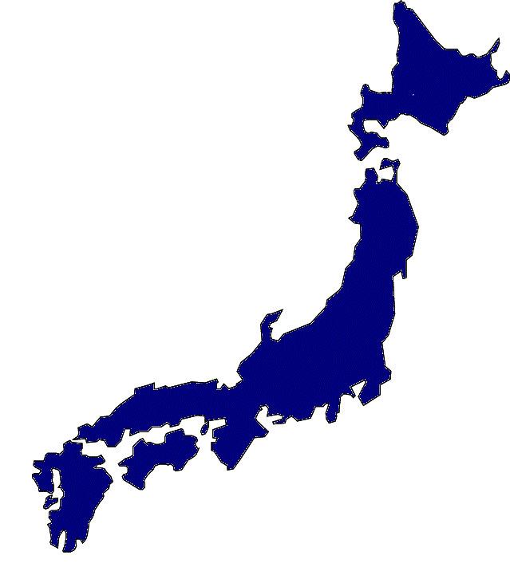
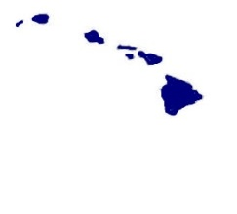
QM Active Duty Locations
GERMANY
21st Sustainment CMD
16th Sustainment BDE
Sup SQDRN 2 CAV
391st Support BN
18th Support BN
173rd Support BN (IT)
412th Support BN
24th Support BN
5th QM DET
26th QM DET
KOREA
CP Henry
19th Sustainment CMD
CP Casey
402nd SPT BN
602nd SPT BN
70th SPT BN
CP Carroll
HHC, 498TH SPT BN
501ST SUS BDE
CP Humphrey
348TH QM CO
HHC, 194TH SPT BN
JAPAN
10th SPT Group
HHC, 35TH SPT BN
505th QM BN
87th QM DET
ALASKA
Fort Richardson
4TH QM DET HHC, 17TH SPT BN
725th SPT BN
Fort Wainwright
25th SPT BN
New York: Fort Drum
10th SUS BDE
227th SPT BN
94th SPT BN
210th SPT BN
10th SPT BN
548th SPT BN
543rd QM CO
WASHINGTON
Fort Lewis
593RD ESC
24TH QM CO
295TH QM CO
606TH SPT CO
602NDSPT CO
65TH SPT CO
46TH SPT BN
308TH SPT BN
296THSPT BN
2ND SPT BN
702ND SPT BN
125TH SPT CO
DISTRICT OF COLUMBIA
MDW: 529TH SPT CO
VIRGINIA
Fort Eustis:
7TH TBX
Fort Lee:
54THQM CO
111TH QM CO
COLORADO: Fort Carson
259TH QM CO
59TH QM CO
247TH QM CO QM SPLY CO
43RD SUS BDE
HQS & HQS DET 68TH SUP BN
404TH SPT BN
4TH SPT BN
65TH SPT BN
704TH SPT BN
68th SPT BN
NORTH CAROLINA: Fort Bragg
1ST TSC
11TH QM CO
127TH QM CO
82ND SUS BDE
122 ND SPT BN
82 ND SPT BN
407TH SPT BN
188TH SPT BN
135TH SPT CO
29TH SPT CO
HHD, 264TH SPT BN
HHC, 189TH SPT BN
528TH CS HQ SUST BDE SO A
647TH QM CO
249TH QM CO
364TH SPT BN
307TH SPT BN
782ND SPT BN
583RD SPT BN
54TH SPT BN
189th SPT BN
KANSAS: Fort Riley
1ST SUS BDE
601ST SPT BN
299TH SPT BN
701ST SPT BN
101ST SPTBN
541ST SPT BN
MISSOURI : Fort Leonard wood
0193RD CS BN BSB MNVR EN
California: Fort Irwin
GEORGIA
Hunter AAF:
473RD QM CO
603RD SPT BN
260TH QM BN
110TH QM CO
Fort Stewart:
135TH QM CO
226TH QM CO
3RD SUS BDE
87TH SPT BN
703RD SPT BN
26TH SPT BN
3RD SPT BN
Fort Benning:
203RD SPT BN
SPT SQDRN 11TH ACR
OKLAHOMA
Fort Sill
168TH SPT BN
696TH SPT CO
571ST SPT CO
609TH SPT CO
578TH SPT CO
609TH SPT CO
66TH SPT CO
609TH SPT CO
57TH SPT BN
KENTUCKY
Fort Knox:
3RD ESC
201ST SPT BN
Fort Campbell:
227TH QM CO
101ST SUS BDE
563ND SPT BN
626TH SPT BN
426TH SPT BN
HQS & HQS DT 129TH SPT BN
129th SPT BN
96TH SPT BN
305TH QM CO
20TH QM CO
526TH SPT BN.
Hawaii
TEXAS
Fort Hood:
13TH ESC
27TH SPT BN
575TH SPT BN
SPT SQD 3RD CAV
127TH SPT BN
589TH SPT BN
215TH SPT BN
115TH SPT BN
15TH SPT BN
53RD QM CO
565THQM CO
289TH QM CO
67TH SPT BN
Fort Shafter
8TH TSC
740TH CS CO FSC
302ND QM CO
Schofield Barracks
45TH SUS BDE
540TH QM CO
6TH QM CO
40TH QM CO
225TH SPT BN
325TH SPT BN
Wheeler AAF /MSG EARL
209TH SPT BN
962ND QM CO
Fort Hood cont.
62ND QM CO
4TH SUS BDE
615TH SPT BN
553RD SPT BN HHD
Fort Bliss
157TH QM CO
72ND SPT BN
142ND SPT BN
123RD SPT BN
501ST SPT BN
509TH CS CO SPT CO
125TH SPT BN
47TH SPT BN
15TH SUS BDE
LOUISIANA: Fort Polk
94TH SPT BN
88TH SPT BN

Slide 10

QM US Army Reserve Unit Locations
INDIANA
417th QM CO
690th QM DET PETRL
380th QM CO
308th QM TM PETRL
407th QM TM PETRL
624th QM CO
380th QM BN HHD
855th QM CO
MICHIGAN
431st QM CO
13th QM TM PETRL
301st QM CO
952nd QM CO
NEW YORK
1018th QM CO
140th QM CO
277th QM CO
618th QM DET
1019 QM CO
409th QM DET
MINNOSOTA
825th QM DET
OHIO
192nd QM CO
1001st QM CO
633rd QM BN HHD
654th QM DET PETRL
810th QM CO
319th QM BN HHD
NEBRASKA
1013th QM CO
728th QM CO
388th QM TM PETRL
WISCONSIN
753rd QM CO
ILLINOIS
1008th QM CO
831st QM TM PETRL
334th QM CO
CONNECTICUT
439th QM CO
617th QM DET
947th QM CO
334th QM BN HHD
IDAHO
1016th QM CO
IOWA
960th QM CO
NEW JERSEY
445th QM CO
716th QM CO
308th QM CO PETRL
KENTUCKY
373rd QM BN HHC
MASSACHUSETTS
801st QM DET
PENNSYLVANIA
327th QM BN HHD
442nd QM CO
347th QM CO
254th QM CO
475th QM CO
14th QM CO
401st QM DET
635th QM DET
326th QM CO
402nd QM BN HHD
475th QM GROUP HHC
233rd QM CO
WYOMING
651st QM CO
CALIFORNIA
387th QM CO (MA)
137th QM CO
968th QM CO
155th QM TM PETRL
329th QM CO
1017th QM CO
606th QM TM PETRL
DELAWARE
673rd QM CO (MA)
MARYLAND
611th QM CO
WEST VIRGINIA
653rd QM TM PETRL
328th QM DET
UTAH
786th QM CO
651st QM DET PETRL
652nd QM DET PETRL
NORTH CAROLINA
362nd QM BN HHD
824th QM CO
431st QM DET
VIRGINIA
650th QM TM PETRL
942nd QM DET
275th QM CO
751st QM CO PETRL
988th QM CO PETRL
ARIZONA
452nd QM CO
655th QM TM PETRL
418th QM BN HHD
TEXAS
1002nd QM CO
263rd QM CO
645th QM DET
141st QM CO
363rd QM BN HHD
383rd QM BN HHC
900th QM CO
15th QM DET PETRL
974th QM CO
961st QM CO
340th QM CO
288th QM CO
971st QM DET
310th QM TM PETRL
957th QM CO
331st QM TM PETRL
242nd QM CO
883rd QM CO PETRL
320th QM TM PETRL
NEW MEXICO
372nd QM BN HHD
877th QM CO
985th QM DET
809th QM DET
315th QM TM PETRL
GEORGIA
377th QM CO
421st QM CO
KANSAS
824th QM DET
842nd QM CO
863rd QM DET
TENNESSEE
861st QM CO
FLORIDA
410th QM DET
303rd QM CO
HAWAII
302nd QM CO
962nd QM CO (MA)
OKLAHOMA
316th QM BN HHD
910th QM CO
411th QM TM PETRL
MISSISSIPPI
173rd QM CO
894th QM CO
PUERTO RICO
597th QM CO
311th QM CO
941st QM CO
969th QM DET
246th QM CO
430th QM CO
973rd QM CO
MISSOURI
383rd QM CO
As of 19 Nov 14

Slide 11
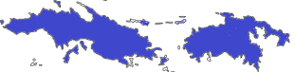
QM Army National Guard Unit Locations
ALASKA
297th QM DET
NORTH DAKOTA
133nd QM DET
134th QM DET
132nd QM CO
MASSACHUSSETTS
220th QM DET
125th QM CO
MICHIGAN
464th QM CO
INDIANA
338th QM CO
NEW JERSEY
820th QM DET
154th QM CO
CALIFORNIA
1040th QM CO
159th QM DET
MARYLAND
158th QM DET
NEVADA
100th QM CO
SOUTH CAROLINA
741st QM CO
MISSOURI
735th QM CO
PUERTO RICO
219th QM DET
105th QM CO
714th QM CO
GEORGIA
165th QM CO
TEXAS
294th QM CO
MISSISSIPPI
1387th QM CO
ALABAMA
1207th QM DET
1208th QM CO
VIRGIN ISLANDS
610th QM CO
630th QM DET
As of 19 Nov 14

Slide 12
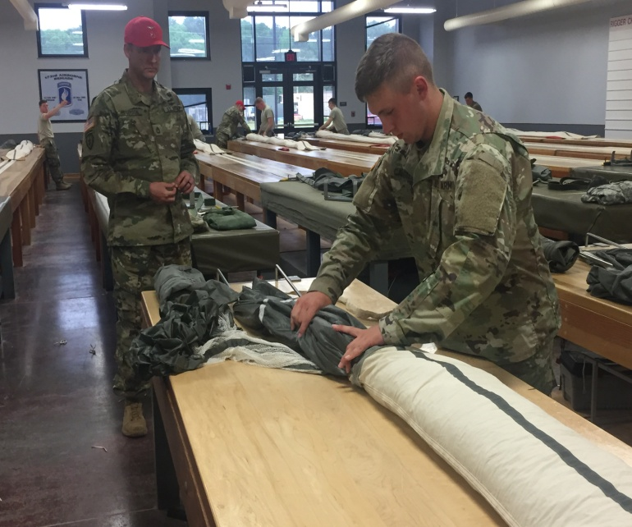
Quartermaster Contacts
Officer Personnel Developer
Phone: 804-734-4503
E-mail: usarmy.lee.tradoc.list.qm-officer-personnel-dev@mail.mil
www.quartermaster.army.mil/

Slide 13
Quartermaster Overview
LARGE BRANCH
LEADS TO MORE
OPPORTUNITIES
EXPERIENCE GAIN
TRANSLATES TO CIVILIAN
JOBS OPPORTUNITIES
SPECIAL QM OFFICER SKILL IDENTIFIERS
DIVERSE JOB ASSIGNMENTS
COMMAND OPPORTUNITIES
SERVE IN LOCATIONS AND UNITS
WORLD WIDE
MOST DIVERSE
BRANCH
DIVERSE EDUCATION AND
BROADENING
OPPORTUNITIES

Slide 14
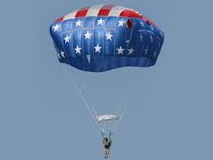
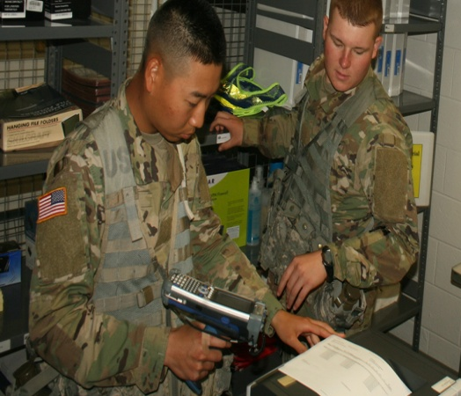

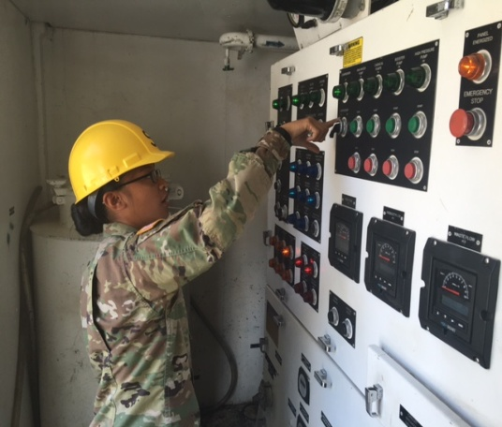
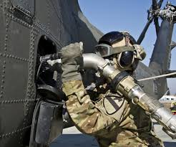
Questions
Aerial Delivery
Supply Distribution
Mortuary Affairs
Subsistence
Field Services
Petroleum/Water

